Slide 1
MATLAB Tutorial 12
ENME 303 Computational Methods for Engineers
Parham Oveissi

Slide 2
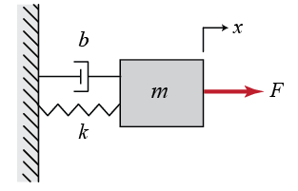

Mass Spring Damper
Consider the mass spring damper system:
Rewrite the given second order ODE as a system of first order ODEs.
$$q$$
$$m\ddot{q}+b\dot{q}+kq=F$$

Slide 3

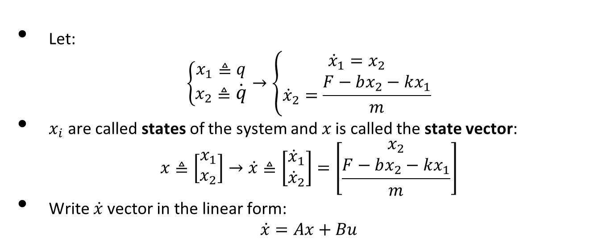
Mass Spring Damper
Let:
$$\left\{\begin{aligned}x_{1}≜q \\ x_{2}≜\dot{q}\end{aligned}\right.→\left\{\begin{aligned}{\dot{x}}_{1}=x_{2} \\ {\dot{x}}_{2}=\frac{F−bx_{2}−kx_{1}}{m}\end{aligned}\right.$$
$x_{i}$ are called states of the system and $x$ is called the state vector:
$$x≜\left[\begin{matrix}x_{1} \\ x_{2}\end{matrix}\right]→\dot{x}≜\left[\begin{matrix}{\dot{x}}_{1} \\ {\dot{x}}_{2}\end{matrix}\right]=\left[\begin{matrix}x_{2} \\ \frac{F−bx_{2}−kx_{1}}{m}\end{matrix}\right]$$
Write $\dot{x}$ vector in the linear form:
$$\dot{x}=Ax+Bu$$
$$m\ddot{q}+b\dot{q}+kq=F$$

Slide 4
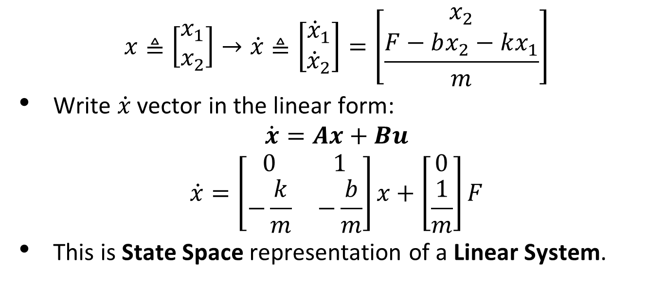
Mass Spring Damper
$$x≜\left[\begin{matrix}x_{1} \\ x_{2}\end{matrix}\right]→\dot{x}≜\left[\begin{matrix}{\dot{x}}_{1} \\ {\dot{x}}_{2}\end{matrix}\right]=\left[\begin{matrix}x_{2} \\ \frac{F−bx_{2}−kx_{1}}{m}\end{matrix}\right]$$
Write $\dot{x}$ vector in the linear form:
$$\dot{x}=Ax+Bu$$
$$\dot{x}=\left[\begin{matrix}0 & 1 \\ −\frac{k}{m} & −\frac{b}{m}\end{matrix}\right]x+\left[\begin{matrix}0 \\ \frac{1}{m}\end{matrix}\right]F$$
This is State Space representation of a Linear System.

Slide 5
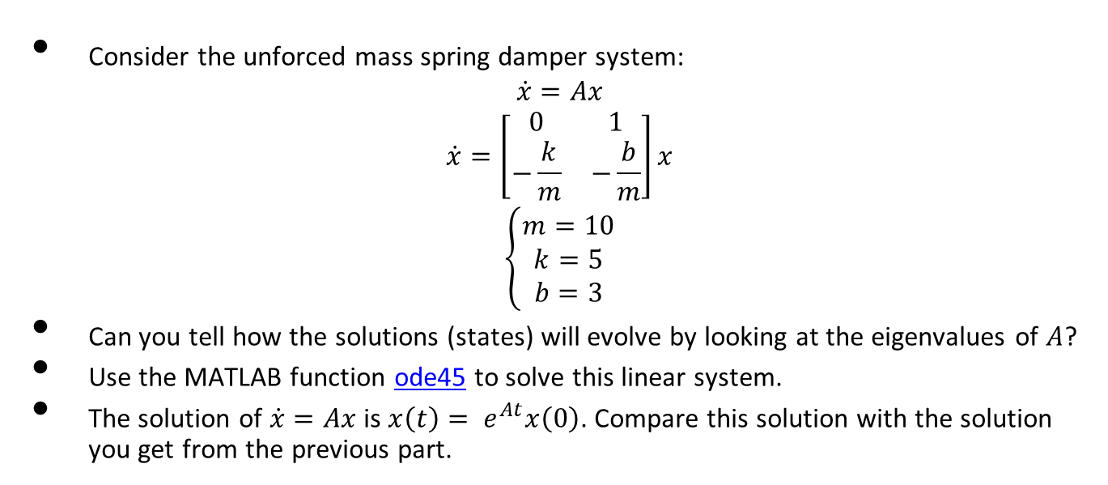
Mass Spring Damper
Consider the unforced mass spring damper system:
$$\dot{x}=Ax$$
$$\dot{x}=\left[\begin{matrix}0 & 1 \\ −\frac{k}{m} & −\frac{b}{m}\end{matrix}\right]x$$
$$\left\{\begin{aligned}m=10 \\ k=5 \\ b=3\end{aligned}\right.$$
Can you tell how the solutions (states) will evolve by looking at the eigenvalues of $A$?
Use the MATLAB function ode45 to solve this linear system.
The solution of $\dot{x}=Ax$is $x\left(t\right)= e^{At}x\left(0\right)$. Compare this solution with the solution you get from the previous part.

Slide 6
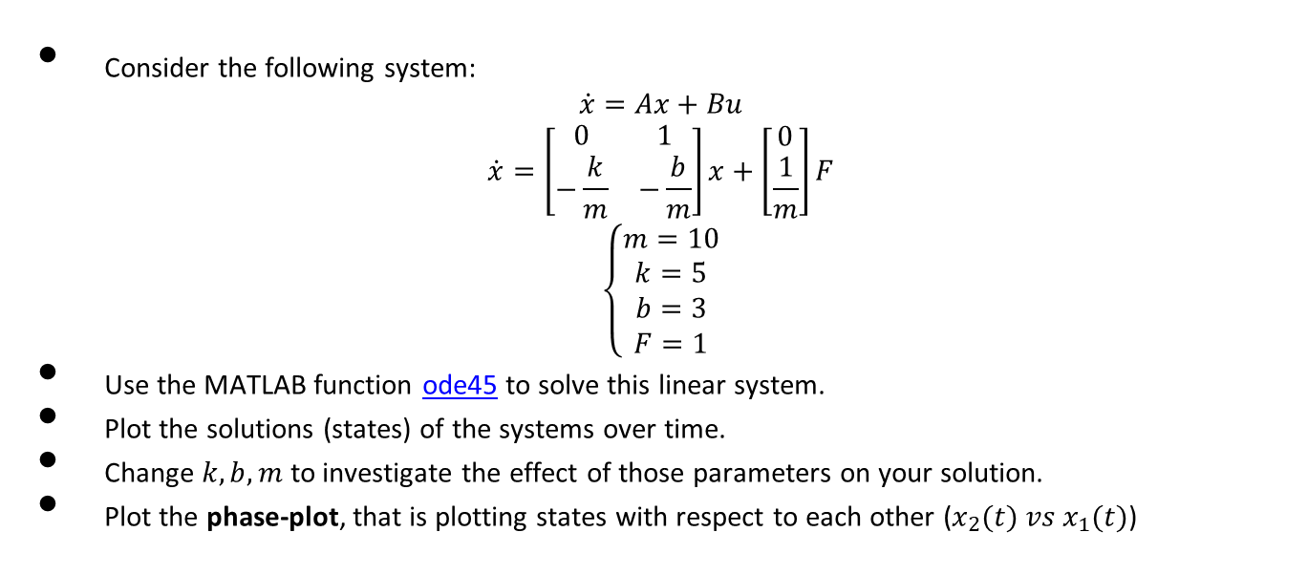
Mass Spring Damper
Consider the following system:
$$\dot{x}=Ax+Bu$$
$$\dot{x}=\left[\begin{matrix}0 & 1 \\ −\frac{k}{m} & −\frac{b}{m}\end{matrix}\right]x+\left[\begin{matrix}0 \\ \frac{1}{m}\end{matrix}\right]F$$
$$\left\{\begin{aligned}m=10 \\ k=5 \\ b=3 \\ F=1\end{aligned}\right.$$
Use the MATLAB function ode45 to solve this linear system.
Plot the solutions (states) of the systems over time.
Change $k,b,m$ to investigate the effect of those parameters on your solution.
Plot the phase-plot, that is plotting states with respect to each other ($x_{2}(t) vs x_{1}(t)$)

Slide 7
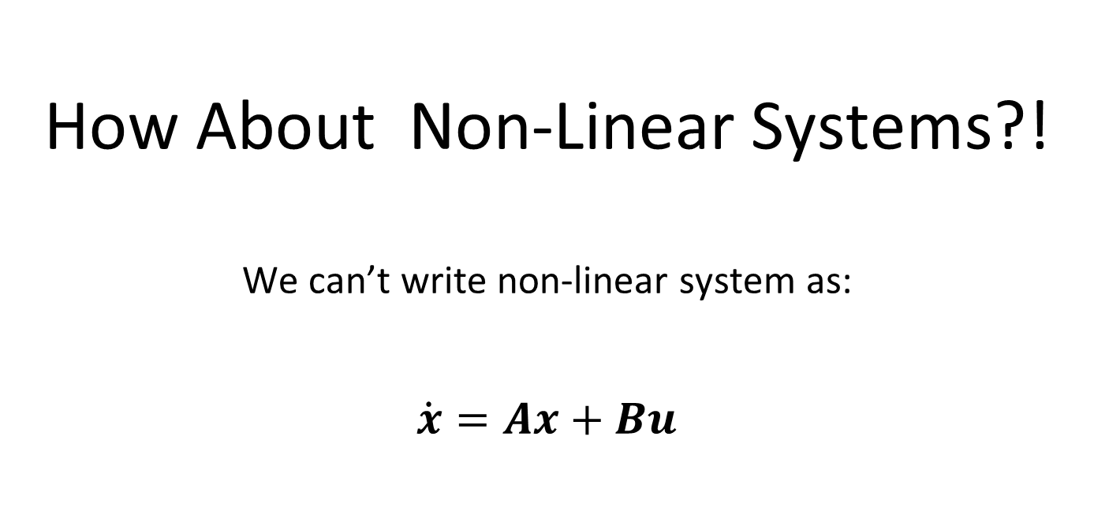
How About Non-Linear Systems?! We can’t write non-linear system as: $$\dot{x}=Ax+Bu$$

Slide 8
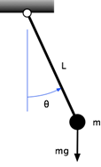


Simple Pendulum
Consider the simple pendulum system:
Use the MATLAB function ode45 to solve this non-linear system.
Plot the solutions (states) of the systems over time.
$$l\ddot{θ}+gsin\left(θ\right)=0$$
$$\left\{\begin{aligned}g=10 \\ l=10\end{aligned}\right.$$
Notes:
s

Slide 9
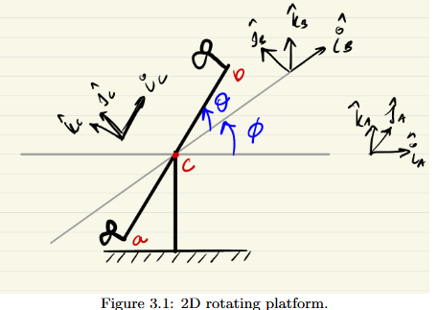
2 DOF Platform

Slide 10
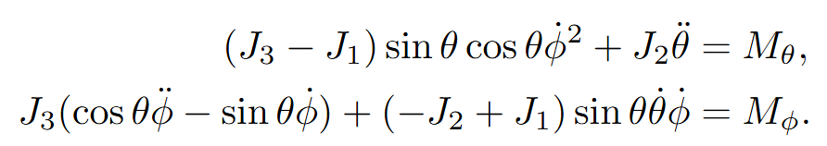
Equations of Motion

Slide 11
Problem
Simulate the system with constant torque inputs
J1 = 0.2, J2 = 0.2, J3 = 0.5;

Slide 12
Thanks!

